Slide 1
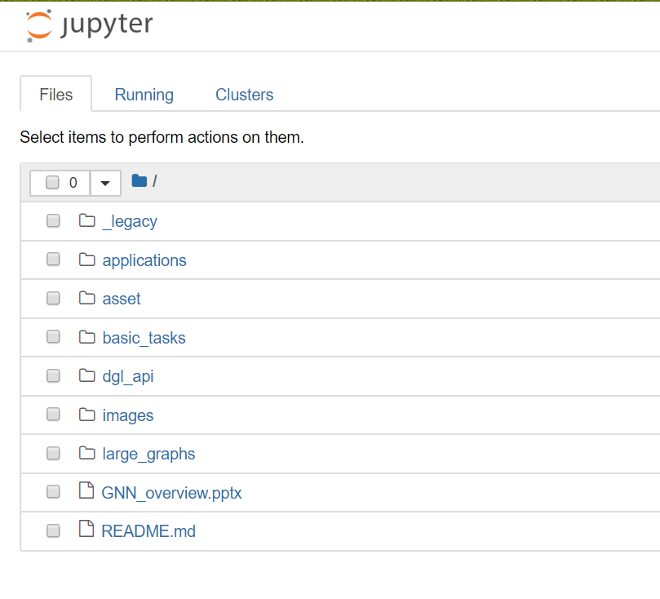

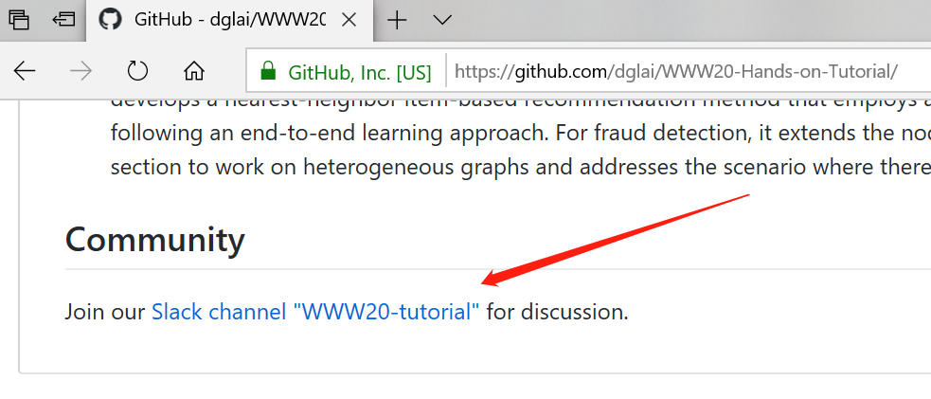
SageMaker Setup Instructions
Send an email to dgl-www@request-nb.mxnet.io
You will receive two emails. Click the notebook link the in the second one.
Need help?
Join our slack channel

Slide 2

Deep Graph Library an update
https:www.dgl.ai
Zheng Zhang
Director, AWS Shanghai AI Lab (zhaz@amazon.com)
zz@nyu.edu (on leave)

Slide 3
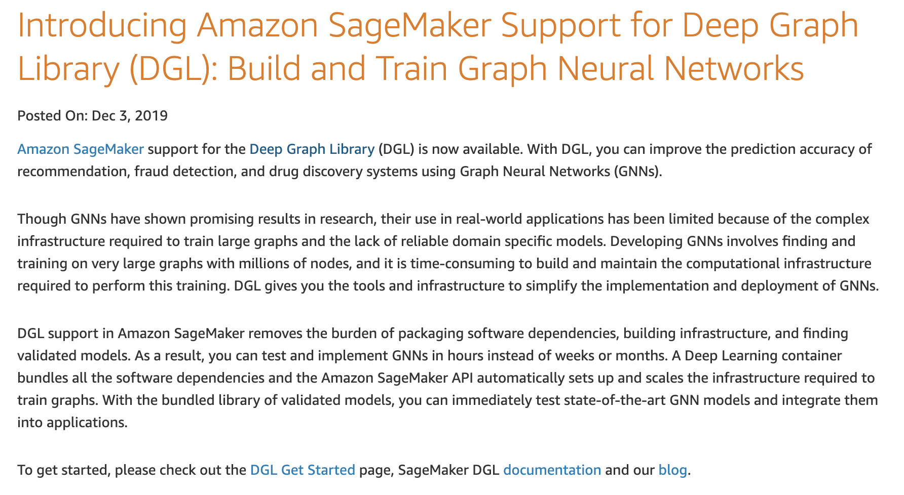
DGL: The history
V0.43
TF support
DGL-KE/DGL-LifeScie
Sampling
V0.3.1
NN modules
DGL-Chem
Development started
V0.2
Sampling APIs
2018
2019
2020
V0.3
Fused message passing
Multi-GPU/-core
First prototype
V0.1
(NeurIPS’18)
V0.4
Heterogeneous graph
DGL-KE (preview)

Slide 4
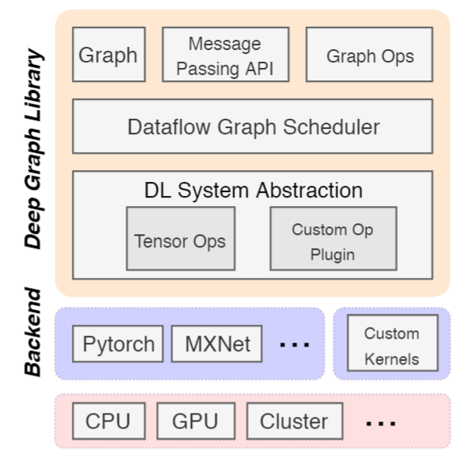
DGL meta-objectives & architecture
Forward and backward compatible
Forward: easy to develop new models
Backward: seamless integration with existing frameworks (MXNet/Pytorch/Tensorflow)
Fast and Scalable

Slide 5
DGL: design & API

Slide 6
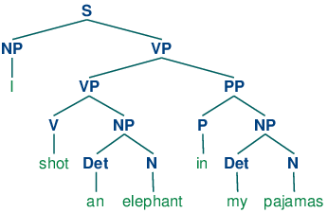
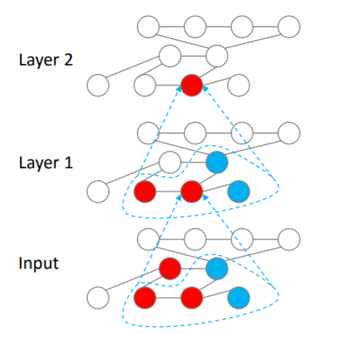
Flexible message propagation
Full propagation (“everyone shouts to everyone near you”)
Propagation by graph traversal
Topological order on sentence parsing tree
Belief propagation order
Sampling
Propagation by random walk

Slide 7
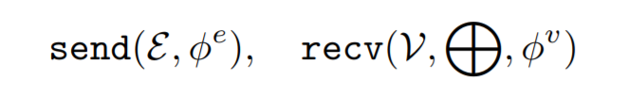
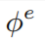
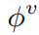
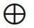
DGL programming interface
Graph as the core abstraction
DGLGraph
g.ndata[‘h’]
Simple but versatile message passing APIs
Active set specifies which nodes/edges to trigger the computation on.
can be user-defined functions (UDFs) or built-in symbolic functions.

Slide 8
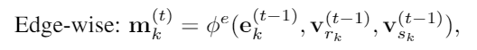
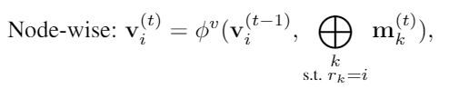
Flexible message handling
Message function
Update function
Reduce function
[Gilmer 2017, Wang 2017, Battaglia 2018]

Slide 9
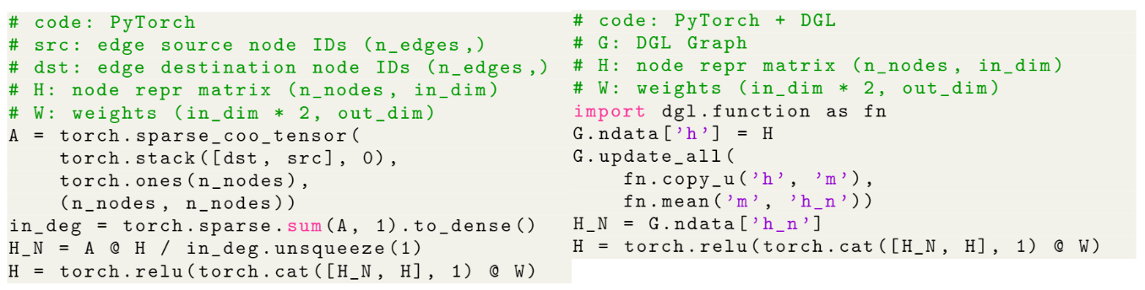
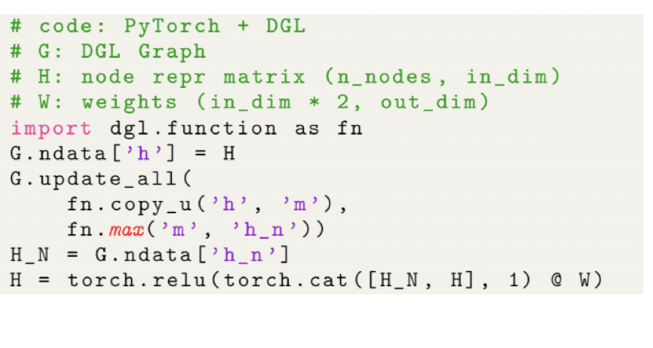
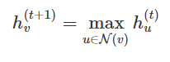
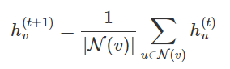
Writing GNNs is intuitive in DGL
update_all is a shortcut for send(G.edges()) + recv(G.nodes())

Slide 10
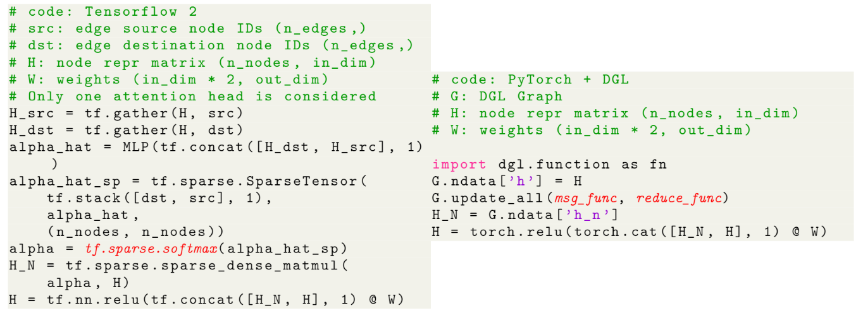
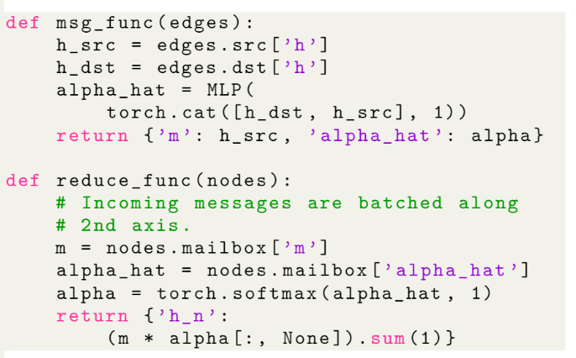
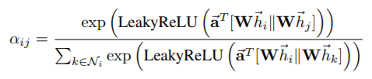
Writing GNNs is intuitive in DGL (GAT)

Slide 11
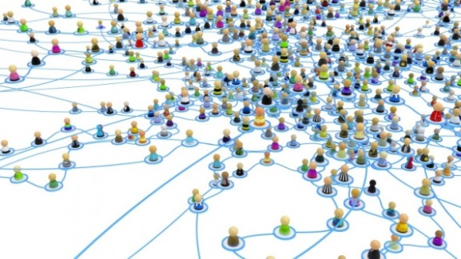
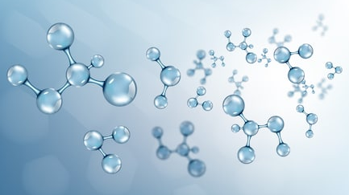
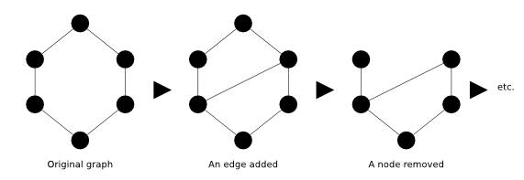
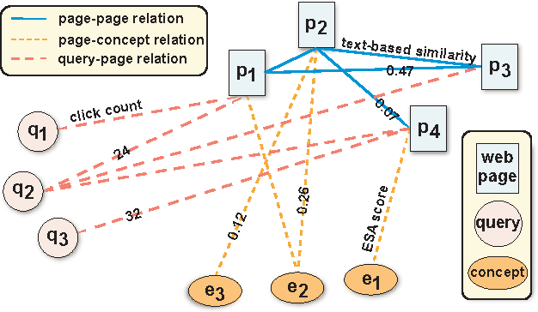
Different scenarios require different supports
Sampling
Batching graphs
Single giant graph
Many moderate-sized graphs
Mutation
Heterogeneous
Dynamic graph
Heterogeneous graph
Notes:
Another design consideration is that graphs in different scenarios require different supports
Community detection: system needs to be memory efficient, and support random walk and graph sampling
Drug discovery, protein property prediction: batching is a high priority
The system should support graph mutation
For example, this graph here represents the interactions in a search engine. A task could be given a query, what is the page returned? This can be casted as a link prediction problem on this graph.

Slide 12
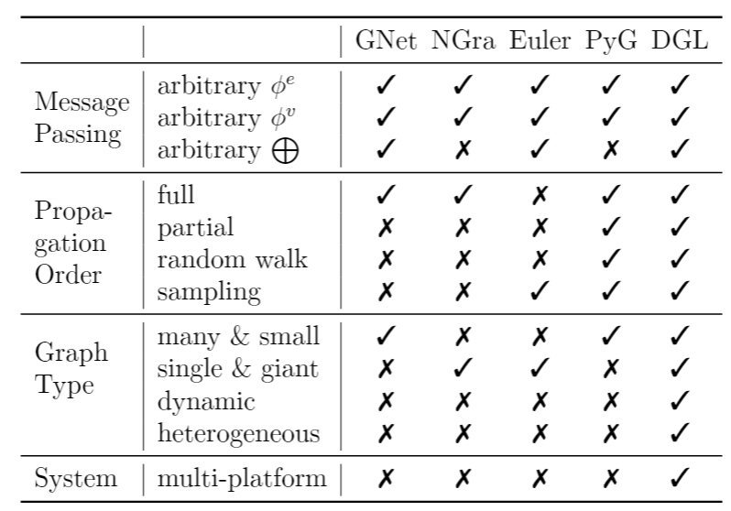
Summary of DGL Programming Interface
User-defined functions
Send, Recv
Active set
Batching APIs
Mutation APIs
Sampling APIs
Support multi-type

Slide 13
Performance evaluation

Slide 14
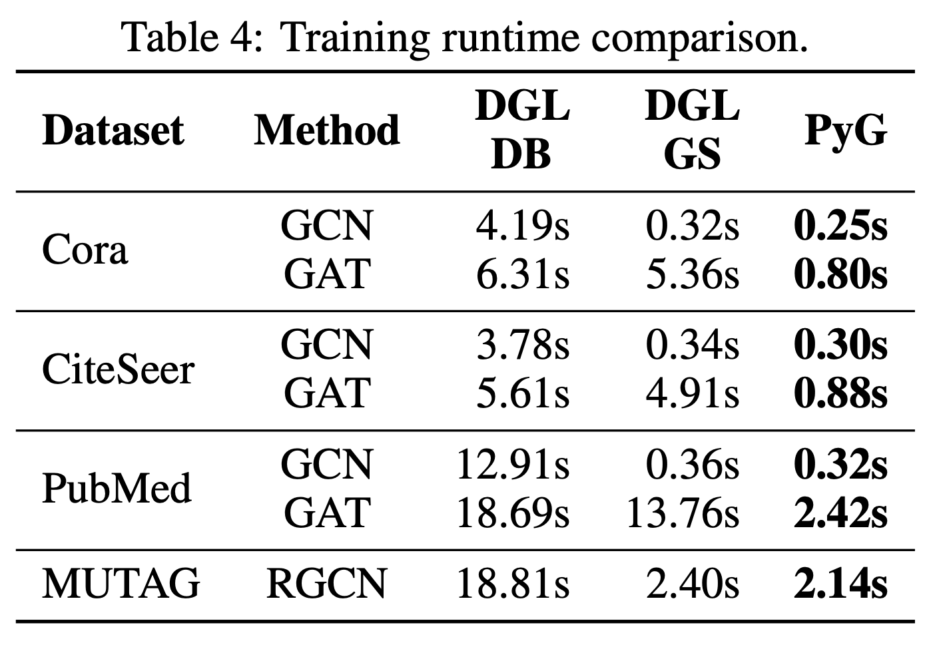
Initially paid a price for multi-backend (woops!)
Fast Graph Representation Learning with PyTorch Geometric

Slide 15
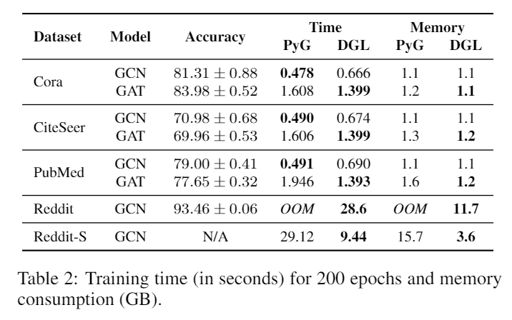
Evaluation: efficiency and memory consumption
Testbed: one V100 GPU (16GB)

Slide 16
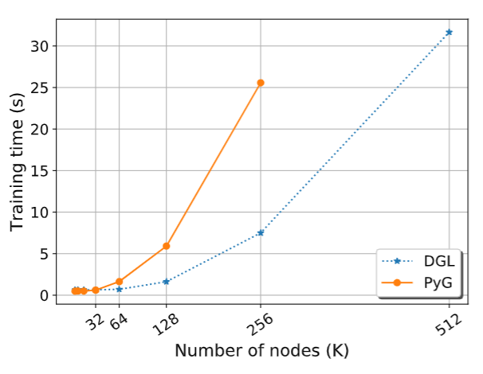
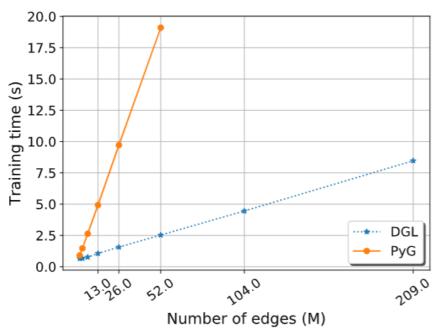
Scalability: single machine, single GPU
3.4x
7.5x
PyG: pytorch-geometric
Scalability with graph size
Scalability with graph density

Slide 17
Scalability: single machine, multi-GPU
p3.16xlarge, 8 V100 GPUs, 64 vCPU
Data set: Reddit (232K nodes, 114M edges)
GraphSage neighbor sampling

Slide 18
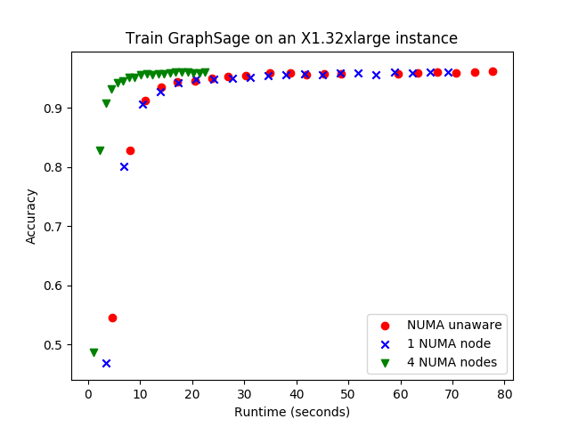
Scalability: single machine, NUMA
X1, 2TB, 128 vCPU
Data set: Reddit (232K nodes, 114M edges)
Controlled-variate sampling

Slide 19
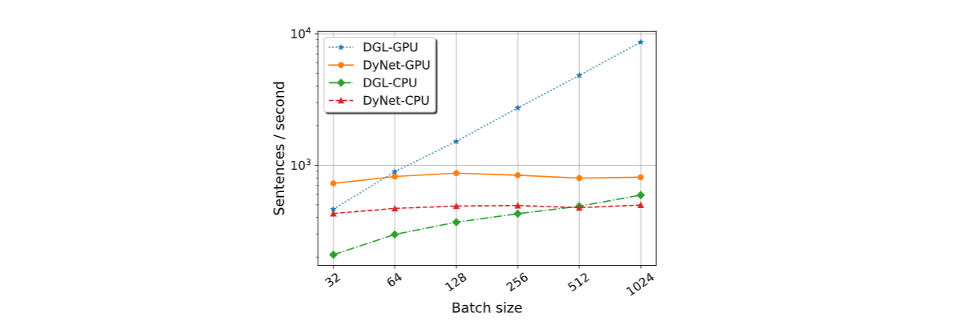
Evaluation: auto-batching
10.6x
Compare with DyNet for training TreeLSTM
Testbed: one V100 GPU (16GB)

Slide 20
What’s new
Release 0.4 and 0.43

Slide 21
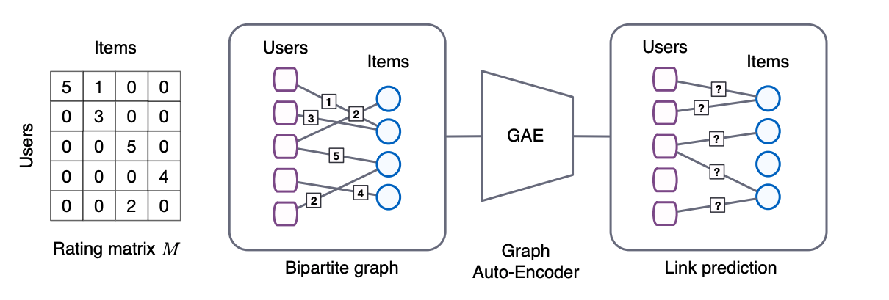
Heterogenous graph
Example: recommendation system, GCMC
Graph Convolutional Matrix Completion

Slide 22
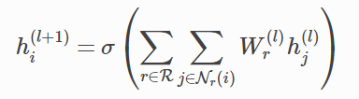
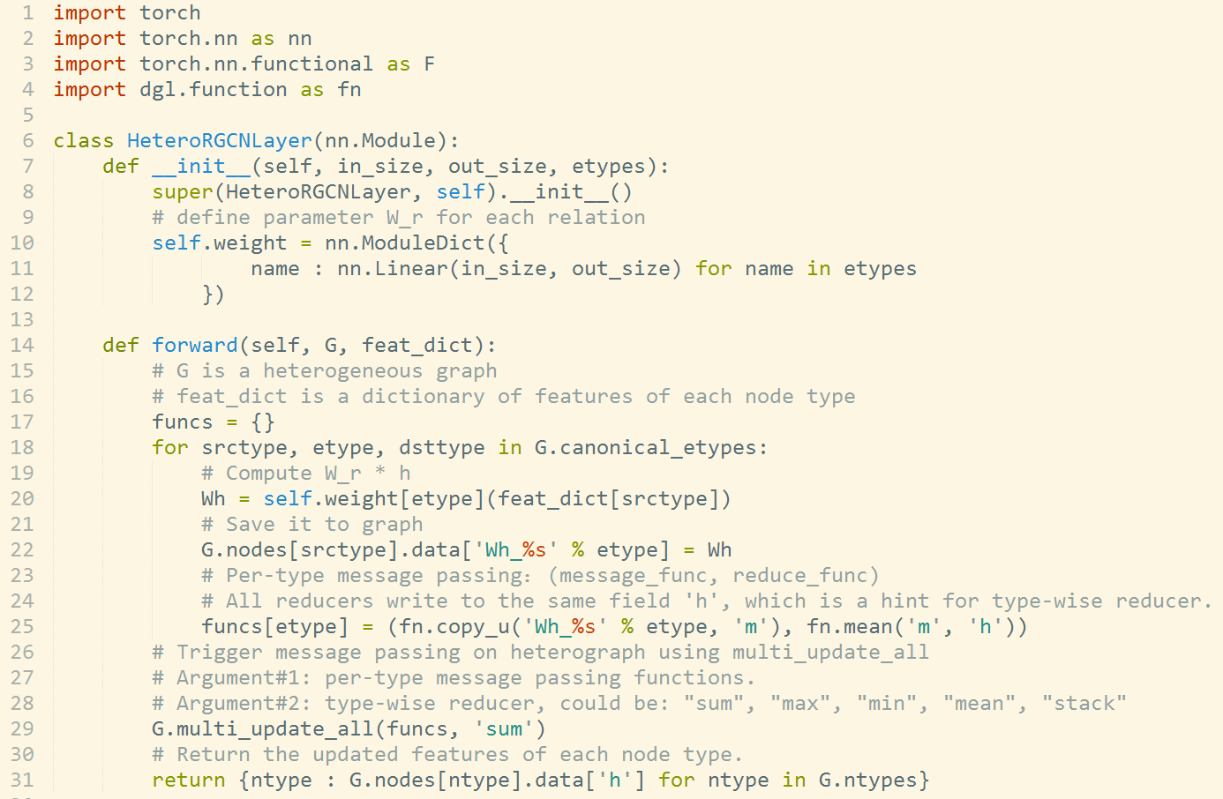
Supporting Heterogeneous Graph

Slide 23
Example: graph convolutional matrix completion
*Official training on MovieLens-10M has to be in mini-batch, which lasts for over 24+ hours
Dataset | RMSE (DGL) | RMSE (Official) | Speed (DGL) | Speed (Official) | Speedup
MovieLens-100K | 0.9077 | 0.910 | 0.0246 s/epoch | 0.1008 s/epoch | 5x
MovieLens-1M | 0.8377 | 0.832 | 0.0695 s/epoch | 1.538 s/epoch | 22x
MovieLens-10M | 0.7875 | 0.777* | 0.6480 s/epoch | Long*

Slide 24
Example: drug discovery
Training time per epoch (1 V100 GPU)
 | DGL | Official | Speedup
ACNN | 0.36 | 1.58 | 4.4x
Atomic Convolutional Neural Network (ACNN)

Slide 25
Digress: even more examples of drug discovery
Training time per epoch (1 V100 GPU)
 | DGL | Official | Speedup
ACNN | 0.36 | 1.58 | 4.4x
JTNN | 743 | 1826 | 2.5x
GCN (Tox21) | 1.9 | 8.4 | 4.4x
AttentiveFP* | 1.2 | 6.0 | 5x
*Pushing the Boundaries of Molecular Representation for Drug Discovery with the Graph Attention Mechanism (GAT, deep, GRU aggregation)

Slide 26
DGL 0.43 Release
Minor release loaded with features:
TF backend support
2 DGL domain packages
DGL-KGE
DGL-LifeSci (5 new models)
Sampling API

Slide 27
0.43 – (1) TensorFlow backend support
15 common GNN modules (including heterography support)
On average x3.5 faster than GraphNet, x1.9 than tf-geometric
Dateset | Model | DGL | GraphNet | tf_geometric
Cora | GCN | 0.0148 | 0.0152 | 0.0192
Reddit | GCN | 0.1095 | OOM | OOM
PubMed | GCN | 0.0156 | 0.0553 | 0.0185
PPI | GCN | 0.09 | 0.16 | 0.21
Cora | GAT | 0.0442 | n/a | 0.058
PPI | GAT | 0.398 | n/a | 0.752

Slide 28
0.43 – (2) DGL-KE:
Light-speed for knowledge graph embedding learning, at scale
2~5 speedup over PyTorch Big Graph/GraphVite
Full FreeBase
86M nodes
348M edges
30min on 4 48core machines

Slide 29
0.43 – (2) DGL-KE: runs on multi-GPU, too
Light-speed for knwledge graph embedding learning, with scale
2~5 speedup over PyTorch Big Graph/GraphVite
FB15K (15K nodes, 592K edges);
Full FreeBase
86M nodes
348M edges
100min on 8-GPU

Slide 30
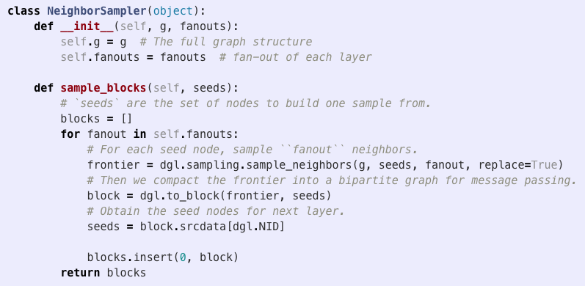
0.43 – (3) Sampling (for giant graph)
Works with many GNNs (PinSAGE, GraphSAGE, GCMC, …)
Support customization in Python.
Support heterogeneous graphs.
Use existing NN modules without code change.
Multi-processing & multi-threading for maximum speed.
Neighbor sampling, +control variate, random walk …

Slide 31
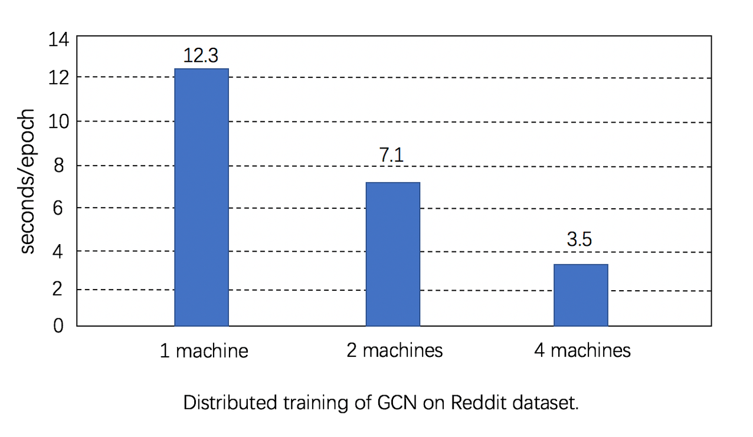
Distributed training: GCN (preliminary results)
Neighbor sampling
Data set: Reddit (232K nodes, 114M edges)
Testbed: c5n.18x, 100Gb/s network, 72vCPU

Slide 32
Seeing the world from the lens of graphs
Small graphs produced every second (e.g. sentences and images)
log(# Graphs created/second)
Strong AI
Several giant graphs changes every second
(e.g. knowledge graph, social networks)
log(Graph size)

Slide 33
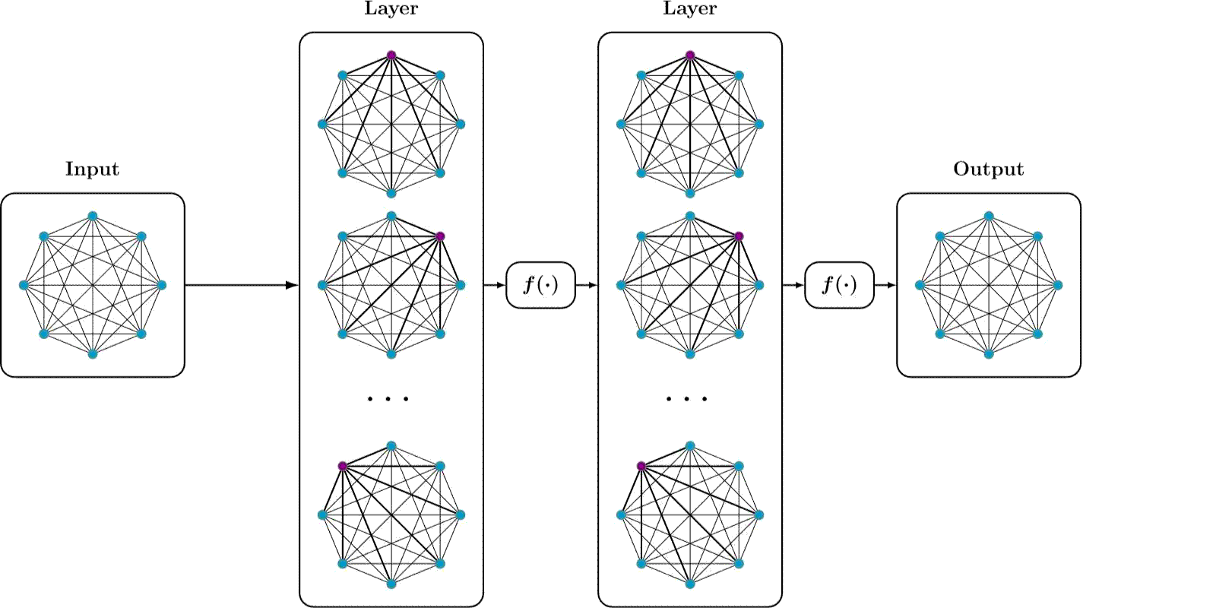
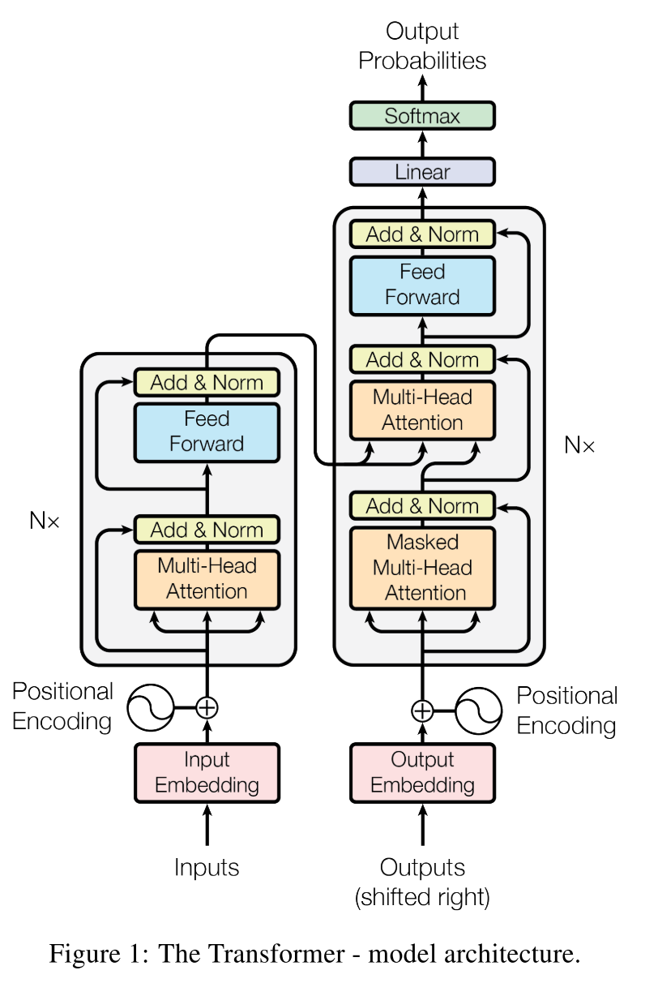
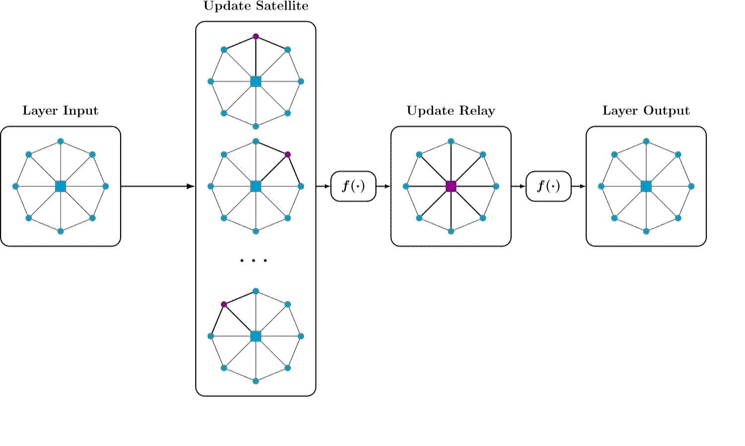
Transfomer is GAT (over a complete graph)
Transformer:
- $O(n^{2})$: data hungry
Star-Transformer (in NAACL’19)
$O(n)$: much less data hungry
Leverages ngram prior, but has issues with long dependency
SegTree-Transformer (in ICLR’19 RLGM)
$O(nlog n )$: less data hungry
A good compromise in between

Slide 34
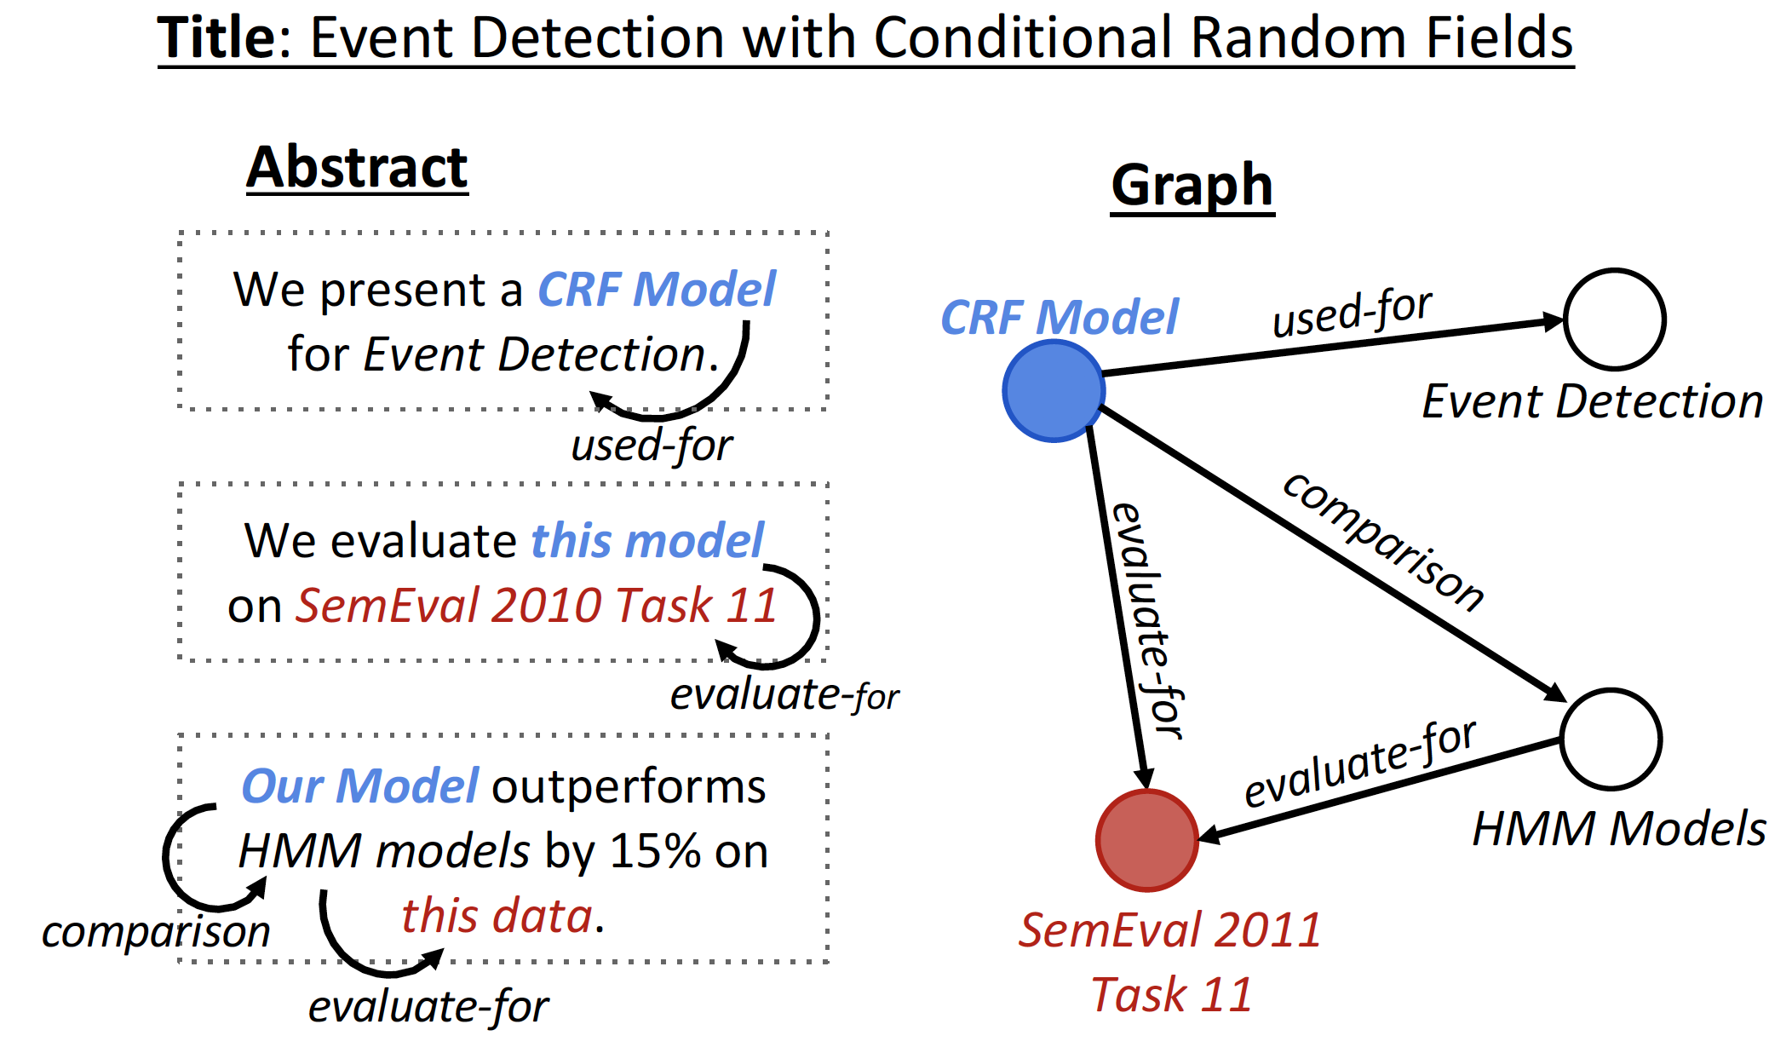
Graph in Natural Language Processing
Knowledge Graph to Sentence
Input: a title and knowledge graph
Output: abstract text
Text Generation from Knowledge Graphs with Graph Transformers

Slide 35
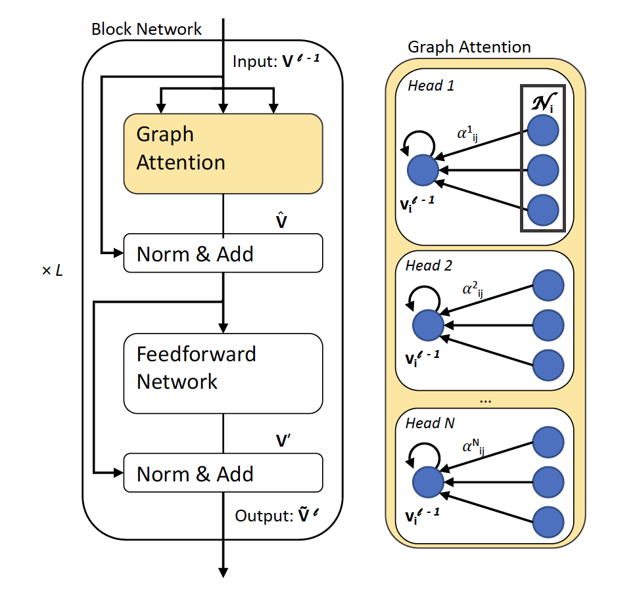
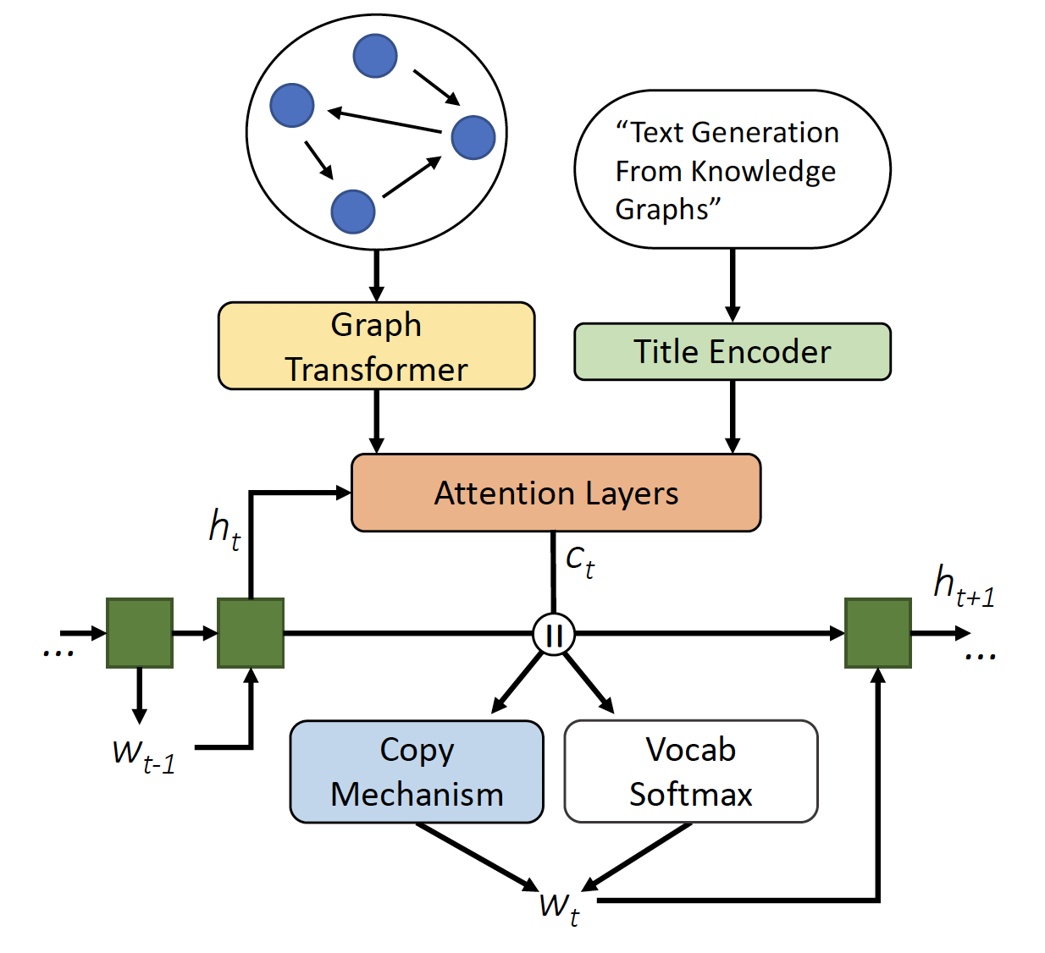
Graph in Natural Language Processing
GraphWriter
Graph Attention
Copy or vocab
DGL | Official | Speedup
1192 (s) | 1970 (s) | 1.7x
Text Generation from Knowledge Graphs with Graph Transformers

Slide 36
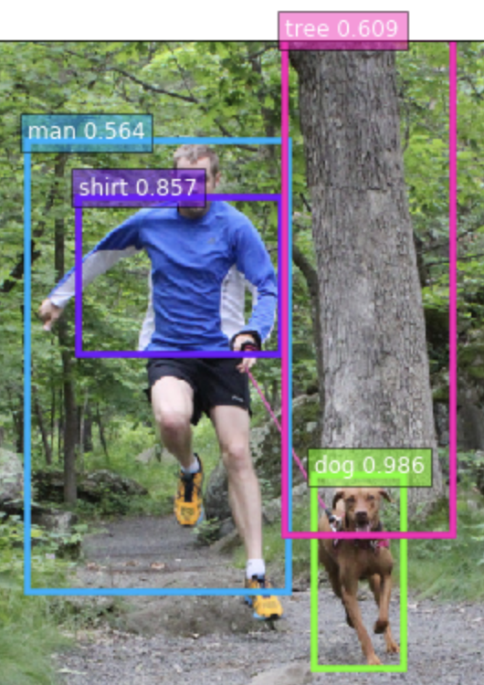
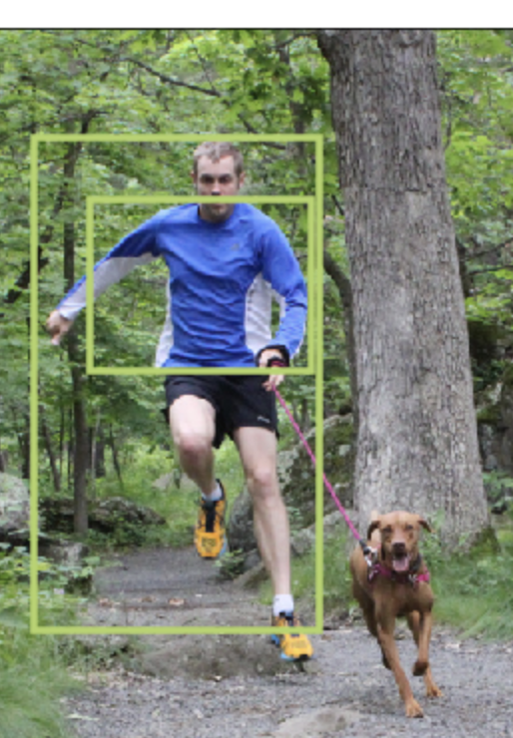
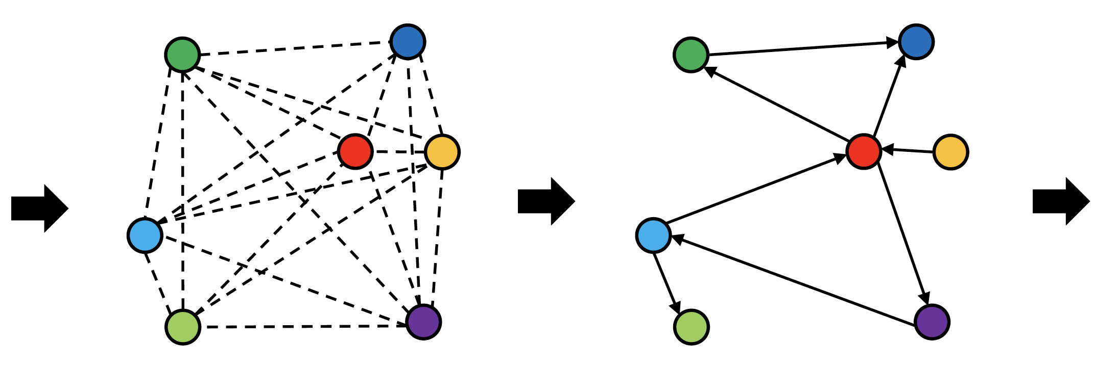
Scene graph extraction (experimental)
Graph R-CNN for Scene Graph Generation
Per epoch time 45min (vs. 2.5hr)
Link exists with prob 68.99%
Link type:
<man> <have> <shirt>, 43.29%
<man> <wear> <shirt>, 39.64%
GCN
Object Detection
Notes:
Our model can be trained in less than one hour as it converges to produce good results. This example also shows the possible ambiguity of relationships, and how the model deals with it.

Slide 37
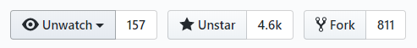
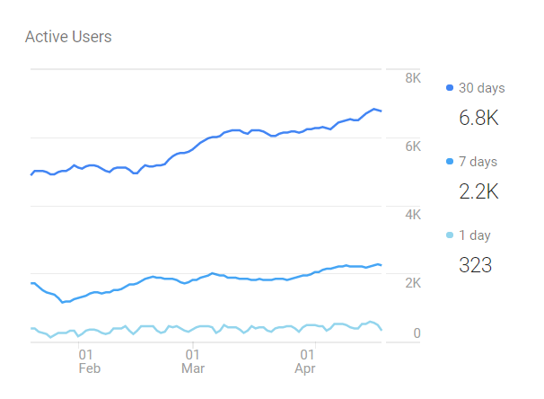
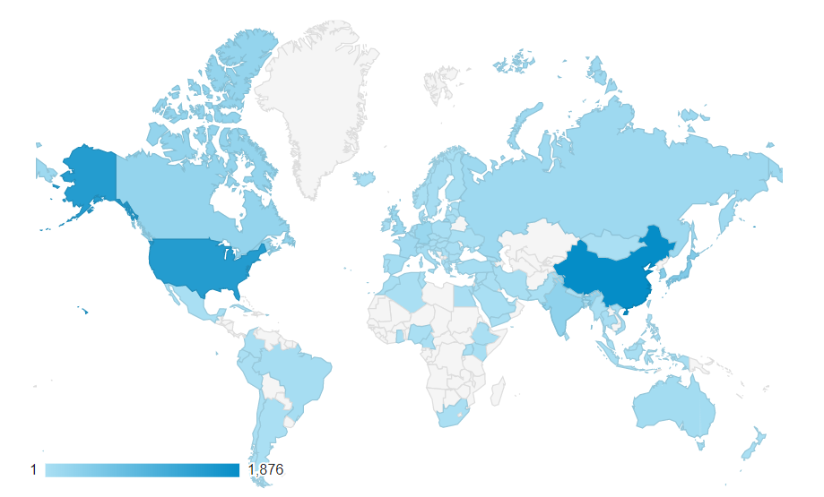
Open source, the source of innovation
Neurips’19
WWW’20
3481 4555 github stars 312k 1770k downloads for all versions on Pip 8.8K 13K downloads for all version on Conda 1.8K 6.4K anaconda downloads of 0.4+ | 32 model examples, 28 NN modules (including 14 15 GNN convolution modules) 6 10 pretrained models for chemistry GCN, generative, KG, RecSys… 45 53 contributors, 10 core developers

Slide 38
DGL: next step(s)
V0.3.1
NN modules
DGL-Chem
V0.43
TF support
DGL-KE/DGL-LifeScie
Sampling
Development started
V0.2
Sampling APIs
2018
2019
2020
V0.3
Fused message passing
Multi-GPU/-core
First prototype
V0.1
(NeurIPS’18)
V0.4
Heterogeneous graph
DGL-KE
V0.5
Distributed training

Slide 39
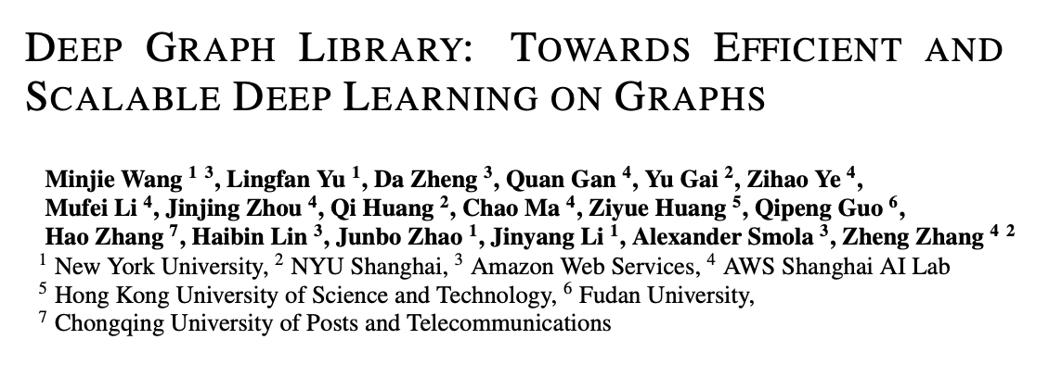
Q&A
Welcome contributions! Please cite:
Leverage
George Karypis (Univ Minnesota/AWS)
Discover
We are hiring!

